Slide 1
Ensemble Learning
Atul Kahate
https://www.linkedin.com/in/atulkahate/

Slide 2
Ensemble
Learning
Combining multiple models (often called "base learners") to solve a single problem, with the goal of producing a more accurate and robust prediction than any individual model could achieve on its own
"Council of Experts"—if one model has a blind spot, the others can compensate for it
Aspect | Bagging (Bootstrap Aggregating) | Boosting | Stacking (Stacked Generalization)
Main goal | Reduce variance (overfitting) | Reduce bias (underfitting) | Improve overall predictive power
Core intuition | “Many independent models vote” | “Learn from mistakes step by step” | “Combine different model strengths”
How models are trained | In parallel | Sequentially | Base models first, then meta-model
Data sampling | Random bootstrap samples | Same data, but weighted | Same data, predictions become features
Model focus | All models treated equally | Later models focus on hard cases | Meta-model learns best combination
Sensitivity to noise | Low | High (can over-focus on noise) | Medium
Typical base models | High-variance models (Decision Trees) | Weak learners (shallow trees) | Any mix (KNN, SVM, Trees, NN)
Final prediction | Average / majority vote | Weighted sum | Meta-model output
Key examples | Random Forest | AdaBoost, Gradient Boosting, XGBoost | Stacked classifiers/regressors
When to use (simple rule) | Model overfits | Model underfits | Multiple good but different models

Slide 3
Bagging
Feature | Single Decision Tree | Bagging (Random Forest)
Stability | Low (changes with data) | High (stable and robust)
Overfitting | High Risk | Low Risk
Accuracy | Good | Excellent
Complexity | Simple | Complex (Black Box)
“Divide, Train, Conquer”
Bootstrapping: Create multiple random sub-datasets from the original training data. These are created using sampling with replacement, meaning the same data point can appear multiple times in one subset.
Parallel Training: Train a separate model (usually the same type, like a Decision Tree) on each of these bootstrap samples. Since the samples are different, each model learns slightly different patterns.
Aggregating: Combine the results from all models to get the final output.
For Classification: Majority voting (the class chosen by most models wins)
For Regression: Averaging (the mean of all predicted values)

Slide 4
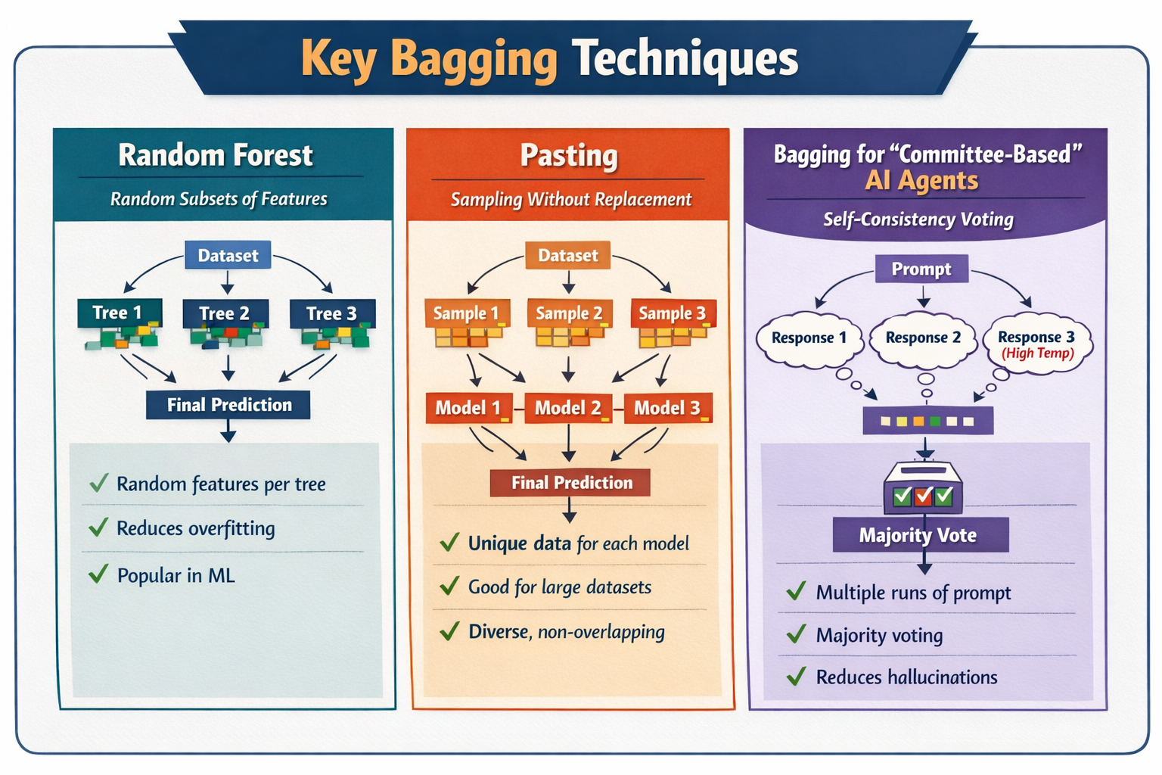

Slide 5
Bagging Techniques
Technique | Description | Key Points / Use Case
Random Forest | A bagging technique using multiple decision trees. Each tree sees a random subset of features when splitting | Reduces correlation between trees Widely used in practice Improves generalization and reduces overfitting
Pasting | Similar to bagging, but samples without replacement | Useful for very large datasets Ensures each model sees unique data points Can slightly reduce variance while keeping diversity
Bagging | Apply bagging concepts to AI/LLM outputs | Self-Consistency: Run same prompt multiple times at high temperature Aggregate outputs via majority vote Reduces hallucinations and increases reliability

Slide 6
Boosting
Sequential strategy where each model learns specifically from the mistakes of its predecessor
Data points that are misclassified by the current model are given higher "weights" or importance in the next round, forcing the next model to focus on the "hard" cases
Technique | Core Idea | How It Learns | Why It’s Important
AdaBoost (Adaptive Boosting) | Pay more attention to mistakes | Increases the weights of misclassified points after each iteration so the next model focuses more on hard cases | Turns many weak learners into a strong one; conceptually simple and historically important
Gradient Boosting (GBM) | Learn to fix the remaining errors | Each new model is trained on the residual errors (actual − predicted) of the previous model using gradient descent | More flexible than AdaBoost; works for regression and classification
XGBoost (Extreme Gradient Boosting) | Do GBM, but faster, safer, smarter | Same residual-learning idea as GBM, but adds regularization, tree pruning, and parallelization | Industry gold standard for tabular data; fast, accurate, and robust against overfitting

Slide 7
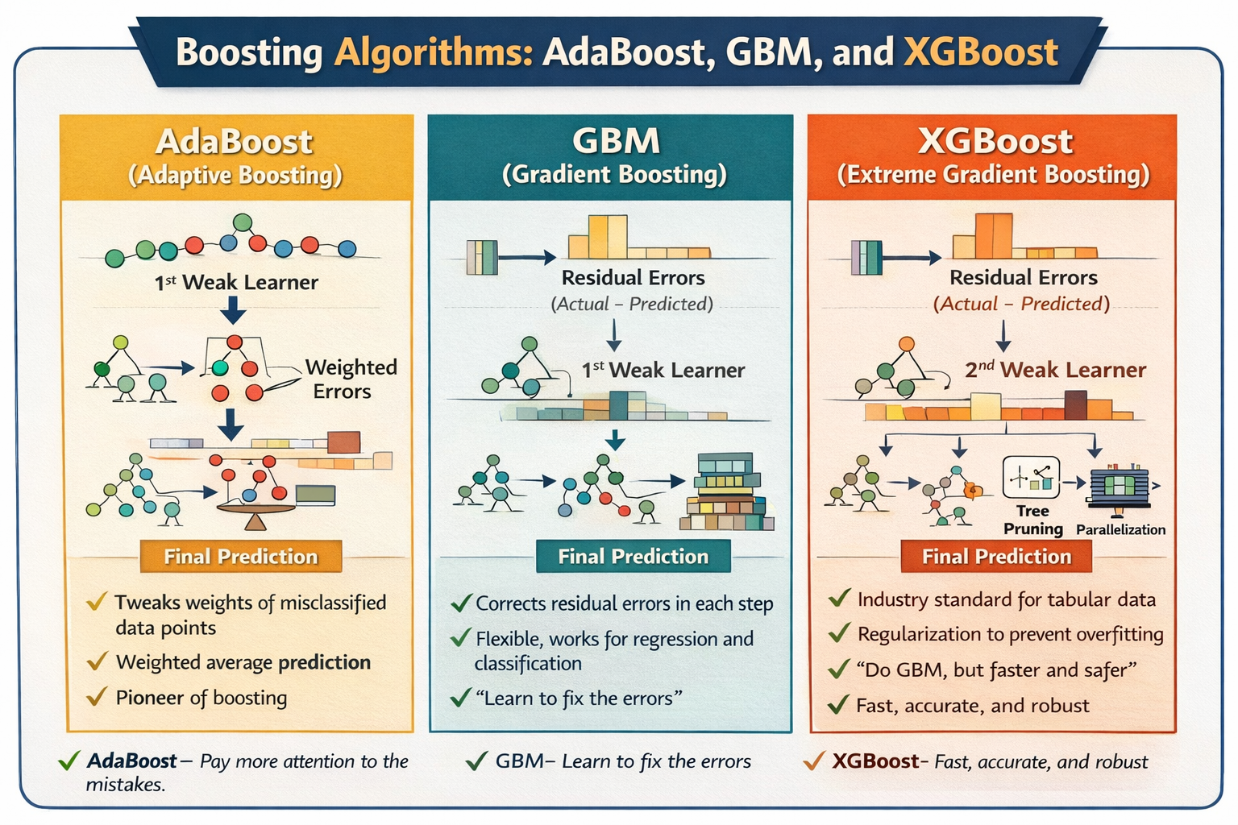

Slide 8
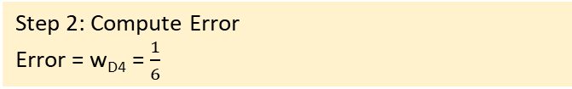
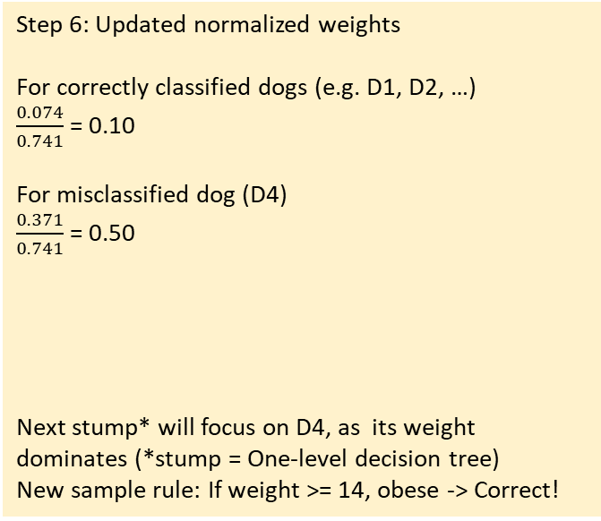
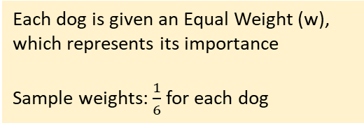
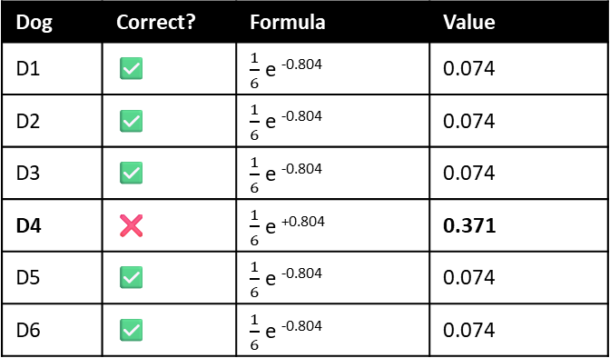

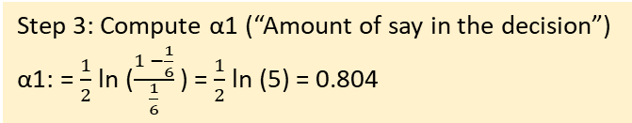
AdaBoost
Step 1 (Weak Learner)
Weak rule: If weight >=16, -> obese
Else -> not obese
Step 5: Updated unnormalized weights
Since the total of weights = 0.741, i.e. not 1, we normalize them = $\frac{Current weight}{Total weight}$
Dog | Correct? | Formula | Value
D1 | ✅ | $\frac{1}{6}$ e ^{-0.804} | 0.074
D2 | ✅ | $\frac{1}{6}$ e ^{-0.804} | 0.074
D3 | ✅ | $\frac{1}{6}$ e ^{-0.804} | 0.074
D4 | ❌ | $\frac{1}{6}$ e ^{+0.804} | 0.371
D5 | ✅ | $\frac{1}{6}$ e ^{-0.804} | 0.074
D6 | ✅ | $\frac{1}{6}$ e ^{-0.804} | 0.074
Builds a sequence of models, where each new model tries to fix the mistakes of the previous one
Dog | Weight | True y | Predicted | Correct?
D1 | 8 | 0 | 0 | ✅
D2 | 10 | 0 | 0 | ✅
D3 | 12 | 0 | 0 | ✅
D4 | 15 | 1 | 0 | ❌
D5 | 18 | 1 | 1 | ✅
D6 | 22 | 1 | 1 | ✅
Dog | Weight (kg) | Obese (y)
D1 | 8 | 0 (Not obese)
D2 | 10 | 0
D3 | 12 | 0
D4 | 15 | 1 (Obese)
D5 | 18 | 1
D6 | 22 | 1
Step 2: Compute Error
Error = w_{D4} ​= $\frac{1}{6}$​
Step 6: Updated normalized weights
For correctly classified dogs (e.g. D1, D2, …)
$\frac{0.074}{0.741}$ = 0.10
For misclassified dog (D4)
$\frac{0.371}{0.741}$ = 0.50
Next stump* will focus on D4, as its weight dominates (*stump = One-level decision tree)
New sample rule: If weight >= 14, obese -> Correct!
Each dog is given an Equal Weight (w), which represents its importance
Sample weights: $\frac{1}{6}$ for each dog
Step 3: Compute α1 (“Amount of say in the decision”)
α1: = $\frac{1}{2}$​ln ($\frac{1 −\frac{1}{6}}{\frac{1}{6}}$) = $\frac{1}{2}$​ln (5) = 0.804
Dog | Normalized Weight
D1 | 0.10
D2 | 0.10
D3 | 0.10
D4 | 0.50
D5 | 0.10
D6 | 0.10
Step 4: Update sample weights
Rule
Misclassified: Increase weight (More important)
Correct: Reduce weight (Less important)
Update formula: wi^{new} = wi . e^{±-α}
Note: Use +α for wrong classifications, - α for correct classifications

Slide 9
GBM
Step 2: Calculate Residuals
Residual = Actual – Predicted
For Dog D1: 0 – 0.5 = -0.5
For Dog D4: 1 – 0.5 = +0.5
Step 5: Calculate the new residuals
For dog D1 (Actual=0): Latest prediction = 0.45
New residual = 0 – 0.45 = -0.45
For dog D2 (Actual=1): Latest prediction = 0.55
New residual = 1 – 0.55 = 0.45
Note: The errors have shrunk from ±0.5 to ±0.45 (See Step 2)
Focuses on the residuals (errors) of the previous model
Dog | Weight (kg) | Obese (y)
D1 | 8 | 0 (Not obese)
D2 | 10 | 0
D3 | 12 | 0
D4 | 15 | 1 (Obese)
D5 | 18 | 1
D6 | 22 | 1
Step 3: Train a weak learner on residuals
We do not use the “Obese” column as the target, but we train it to predict the Residuals we just calculated
=> A “tree” tries to find a threshold that best separates the -0.5 errors from the +0.5 errors
Step 6: Train Tree 2 on the new residuals
Build a second weak learner tree on residuals
New prediction = F₀ + (η x Tree₁ output) + (η x Tree₂ output)
For dog D1, new prediction = 0.5 + (0.1 x -0.5) + (0.1 x -0.45) = 0.405, still more closer to 0
For dog D4, new prediction = 0.5 + (0.1 x 0.5) + (0.1 x 0.45) = 0.595, still more closer to 1
Step 4: Update the prediction with a learning rate
Learning rate “eta” (η) = Small number, e.g. 0.1
New prediction = F₀ + (η x Tree₁ output)
For dog D1, new prediction = 0.5 + (0.1 x -0.5) = 0.45
For dog D4, new prediction = 0.5 + (0.1 x 0.5) = 0.55
Step 1: Initialize with a constant value
Start with a “single leaf” that predicts the average of the target variable for all dogs
Example: Average “Obesity score” for our 6 dogs is 0.5, initial prediction (F₀) for every dog is 0.5
Dog | Actual (y) | Initial Pred (F0​) | New Pred (F0​+η×Tree1​)
D1 (Not Obese) | 0 | 0.5 | 0.45 (Moving toward 0)
D4 (Obese) | 1 | 0.5 | 0.55 (Moving toward 1)
Dog | Actual (y) | Previous Pred (F1​) | New Pred (F2​)
D1 (Not Obese) | 0 | 0.45 | 0.405 (Moving toward 0)
D4 (Obese) | 1 | 0.55 | 0.595 (Moving toward 1)

Slide 10
Stacking
Models learn how to combine other models
Base models make predictions → a meta-model learns from those predictions
Original data -> Base models -> Predictions -> Meta model -> Final prediction
But then how we these numbers decided?
Closer to the True Label -> Higher priority
RF | SVM | KNN | True y
0.8 | 0.6 | 0.7 | 1
0.2 | 0.4 | 0.3 | 0
0.9 | 0.8 | 0.6 | 1
Linear Stacking
Final prediction is a weighted average of base model outputs
Example: Obesity prediction
Non-Linear Stacking
Meta-model is not linear
Example: Obesity prediction
Conclusion
Learning from Reliability: In the first row where the target is 1, Random Forest (0.8) and KNN (0.7) are more accurate than SVM (0.6). The Meta-Model learns to give higher priority to the "confident" models in these scenarios.
Conflict Resolution: Stacking excels when models disagree. For instance, if one model predicts 0.2 and another predicts 0.4 for a True 0, the Meta-Model identifies which model typically handles "Non-Obese" cases with less noise.
The "Expert" Effect: The final decision is not a simple average, but a strategic combination. The Meta-Model essentially says: "I have seen these three experts work before; I know that when RF is this high, it is usually right, so I will trust it more than SVM".
Model | Prediction
Random Forest | 0.8
KNN | 0.6
SVM | 0.7
Non-Linear Meta-model
IF RF > 0.7 AND SVM > 0.6 → Obese
ELSE IF KNN < 0.4 → Not Obese
ELSE → Obese
“Trust different models in different situations”
Linear Meta-model =
(0.5 x 0.8) + (0.3 x 0.6) + (0.2 x 0.7) = 0.72
> 0.5, so Obese
“Each model gets a vote, but some votes matter more)

Slide 11
Bias and Variance
Aspect | Bias | Variance
Cause | Model too simple | Model too complex
Symptom | Poor train & test | Great train, poor test
Fixed by | More complexity | Regularization / averaging
Linked to | Underfitting | Overfitting
Bias
Error caused by wrong assumptions in the model
Meaning: Model is too simple to capture the true pattern
Example
True relationship: y = x²
We choose a model that says: y = ax + b
Straight line cannot fit a curve
Variance
Error caused by the model being too sensitive to the training data
Meaning: Small change in data → big change in model
Overfitting: High variance = model memorizes instead of generalizes
Example
We have 10 data points
Train model A on points 1–10 → curve bends this way
Remove 1 point → curve bends a very different way
Model is unstable → high variance

